Slide 1

Site adaptation 2025 energy meteorology
nadia kairaktidi, 1068622

Slide 2
What is site adaptation
Site adaptation is a method of adapting data from satellite measurements to ground-based measurements. The reason it is a useful method is that ground-based measurements are not always available for a given location.

Slide 3

Ground Measurements
Pros
High frequency measurements (from seconds to minutes)
High accuracy, if properly managed
Cons
Limited geographical representation
Limited temporal availability
Costs for acquisition and operation
Maintenance and calibration
Data quality control

Slide 4

satellite Measurements
Pros
Continuous geographical coverage
Spatial resolution approx. 3 km
Frequency of measurements 15- 30 minutes
Spatial and temporal consistency
High availability (gap-filled data)
> 20 years history
Cons
Lower accuracy
Notes:
A satellite cannot see the radiation as it reaches the Earth but only sees the part of it where it is scattered back and towards it.

Slide 5
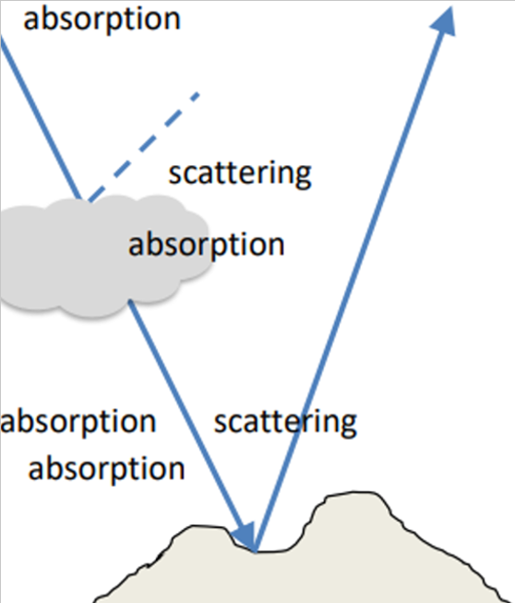
Sources of Uncertainty for satellite data
Extraterrestrial Radiation
Ozone
Air molecules (Rayleigh scattering etc)
Trace Gases (CO₂ etc)
Clouds
Aerosols
Water vapour
Terrain Data (elevation, shadowing, reflection)
Objects (shadowing, reflection)

Slide 6
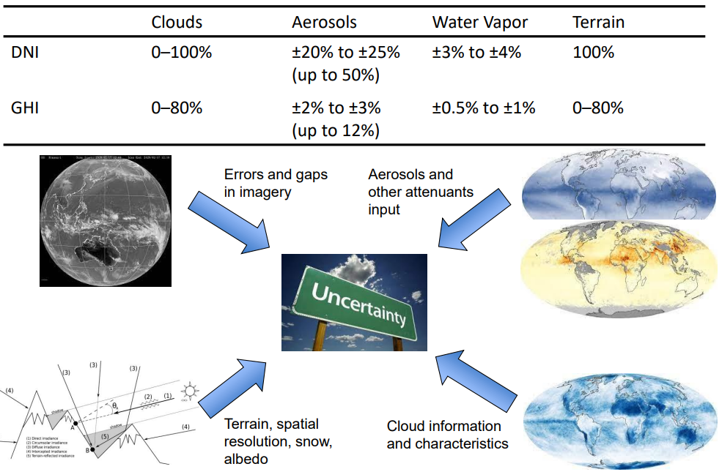
Modelling solar irradiance

Slide 7
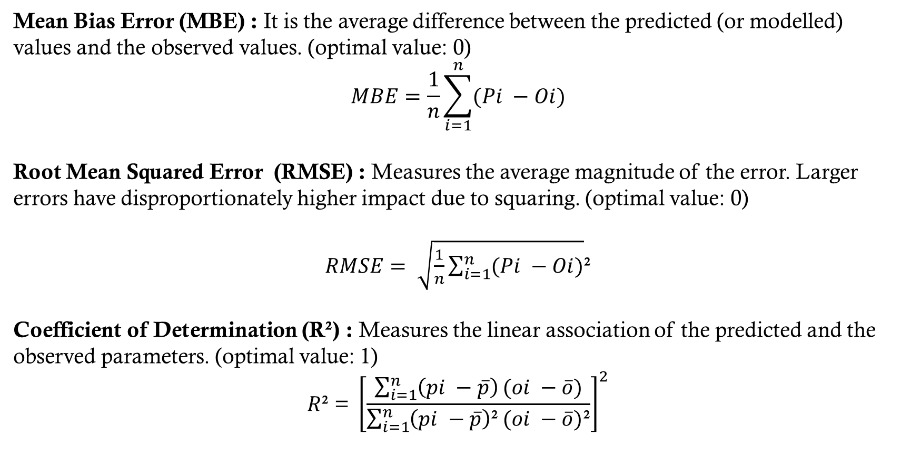
Mean Bias Error (MBE) : It is the average difference between the predicted (or modelled) values and the observed values. (optimal value: 0)
$$MBE=\frac{1}{n}\sum_{i=1}^{n}{(Pi −Oi)}$$
Root Mean Squared Error (RMSE) : Measures the average magnitude of the error. Larger errors have disproportionately higher impact due to squaring. (optimal value: 0)
$RMSE= \sqrt{\frac{1}{n}\sum_{i=1}^{n}{(Pi −Oi)}}$²
Coefficient of Determination (R²) : Measures the linear association of the predicted and the observed parameters. (optimal value: 1)
$$R\text{²}\text{ = }{\left[\frac{\sum_{i=1}^{n}{\left(pi −\overline{p}\right)}(oi −\overline{o})}{\sum_{i=1}^{n}{\left(pi −\overline{p}\right)\text{²}}(oi −\overline{o})\text{²}}\right]}^{2}$$

Slide 8
Site adaptation objectives & requirements
Objectives
Reduced (removed) bias
Improved fit of Cumulative Distribution Functions (CDF)/ histograms
Improved data representativeness
Preserved diurnal profiles
Maintained consistency of GHI, DIF and DNI values
Data Requirements
High quality measurements of solar irradiances (GHI, DIF and DNI)
At least 12 months of measurements (more recommended)
High quality modelled solar irradiances
As result we obtain solar radiation time series with reduced uncertainty.

Slide 9
From theory to practice
Before applying any corrections, we firstly divide our dataset into two periods :
Training period (01/01/2015 – 01/01/2016)
Testing period (01/01/2009 – 31/12/2014)
In this report, two methods of data correction have been tested :
Linear Regression
Empirical Quantile Mapping (EQM)

Slide 10
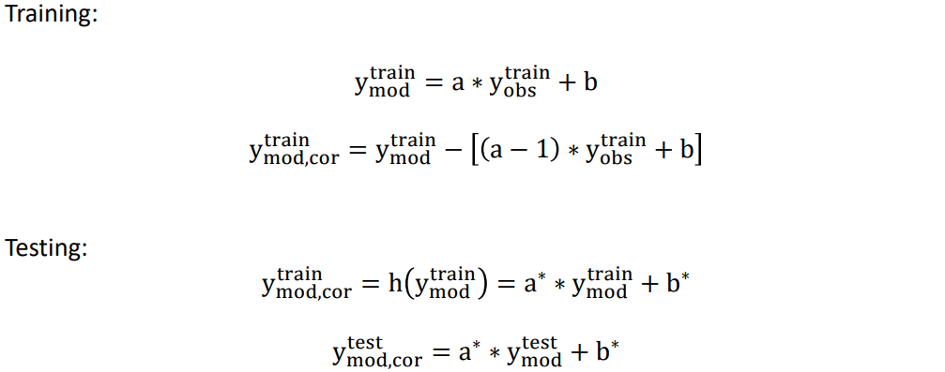
Method 1 : linear regression
Our objective is the complete bias removal, meaning we attempt to fit a line to the cloud of points in a scatter plot and subtract the (1:1) line.

Slide 11
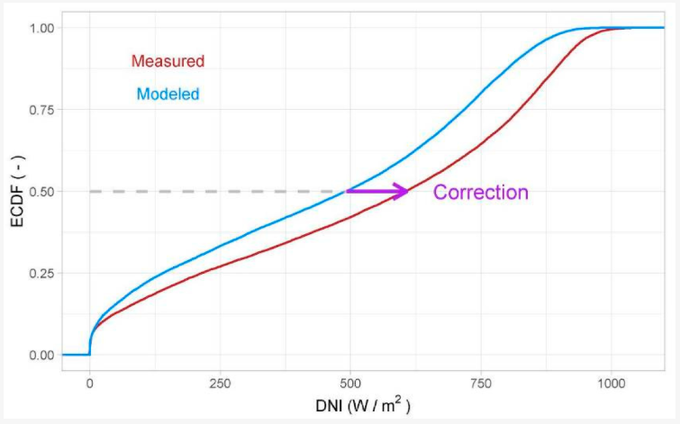

Method 2 : empirical quantile mapping (eqm)
Our objective is to apply a regression-based preprocessing which reduces both the dispersion and bias between measured and modelled data. An EQM correction is applied on modelled data to modify their distribution so that it matches the distribution of the measured data.
The equation describes this process where CDFₘₑₐₛ and CDFₘₒdₑₗ are the cumulative distribution functions of the observed and modelled data.

Slide 12
Training period

Slide 13
Method 1 : linear regression
Our method will be correct if:
The slope is equal to unity
The constant term is equal to zero
MBE is zero
RMSE shows a small improvement

Slide 14
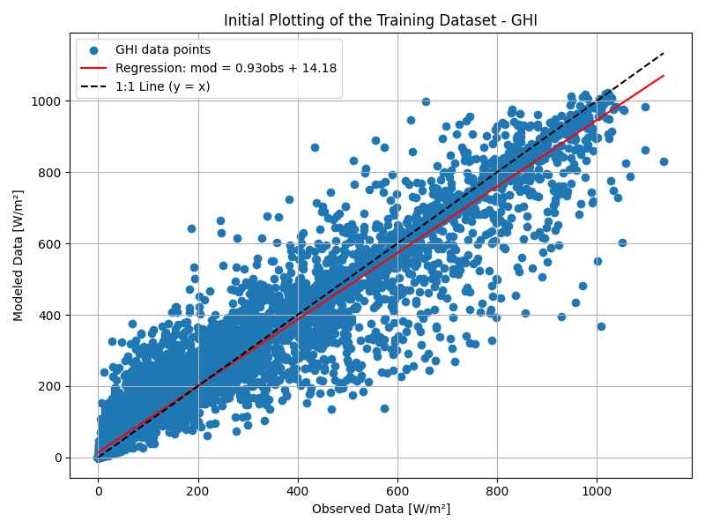
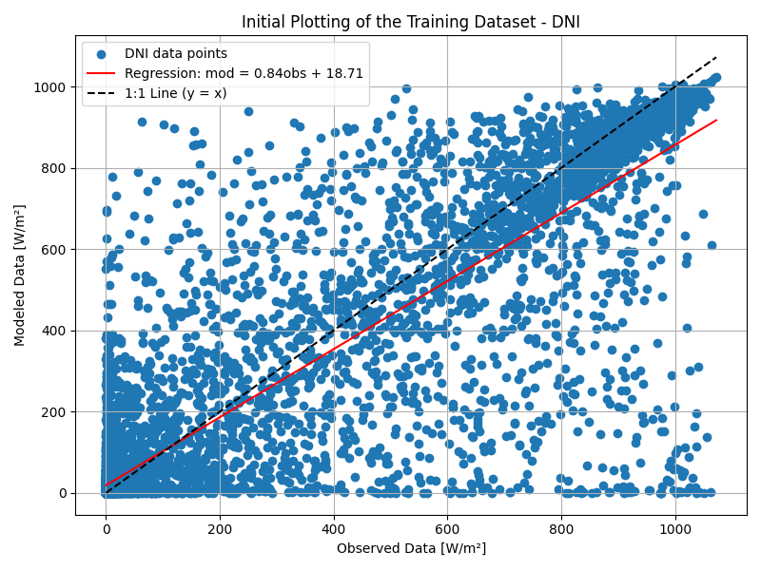
Initial data

Slide 15
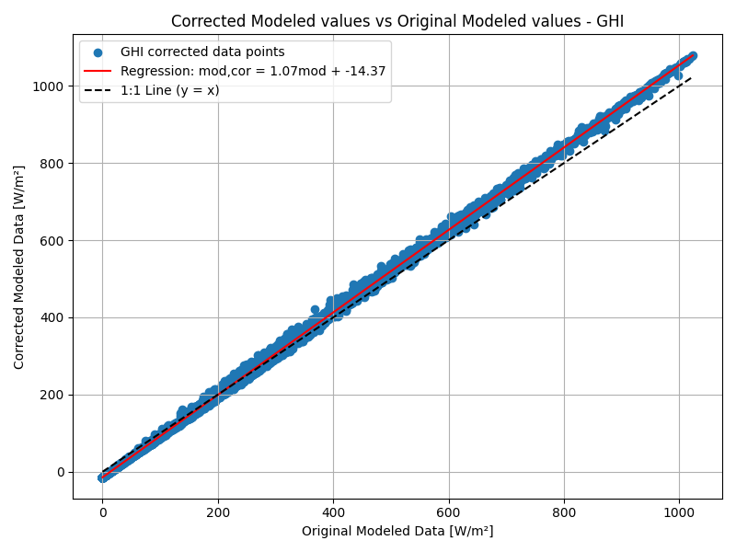
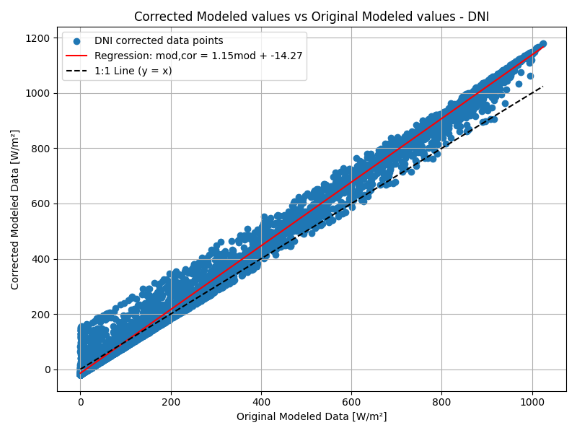
Data correction

Slide 16
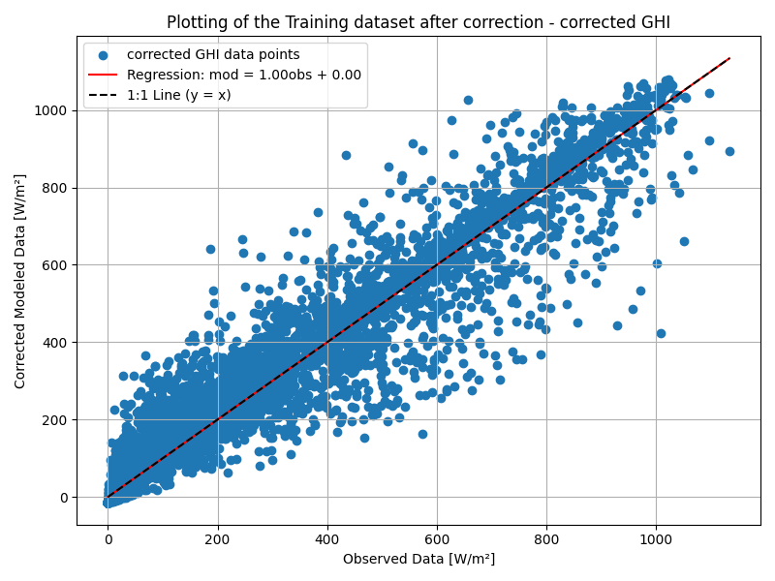
GHI – BEFORE AND AFTER

Slide 17
 | Initial Data | Corrected Data
MBE | 1.55 | 0.00
RMSE | 68.07 | 65.45
R² | 0.938 | 0.946
a | 0.93 | 1.00
b | 14.18 | 0.00

Slide 18
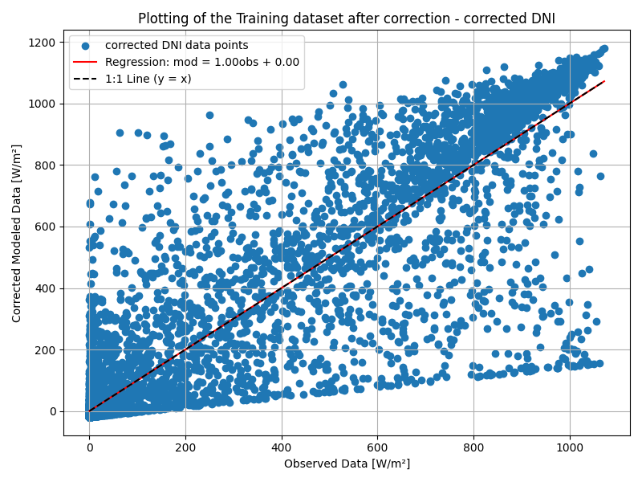
DNI – BEFORE AND AFTER

Slide 19
 | Initial Data | Corrected Data
MBE | -16.00 | 0.00
RMSE | 157.80 | 147.00
R² | 0.790 | 0.842
a | 0.84 | 1.00
b | 18.71 | 0.00

Slide 20
Method 2 : empirical quantile mapping (eqm)

Slide 21
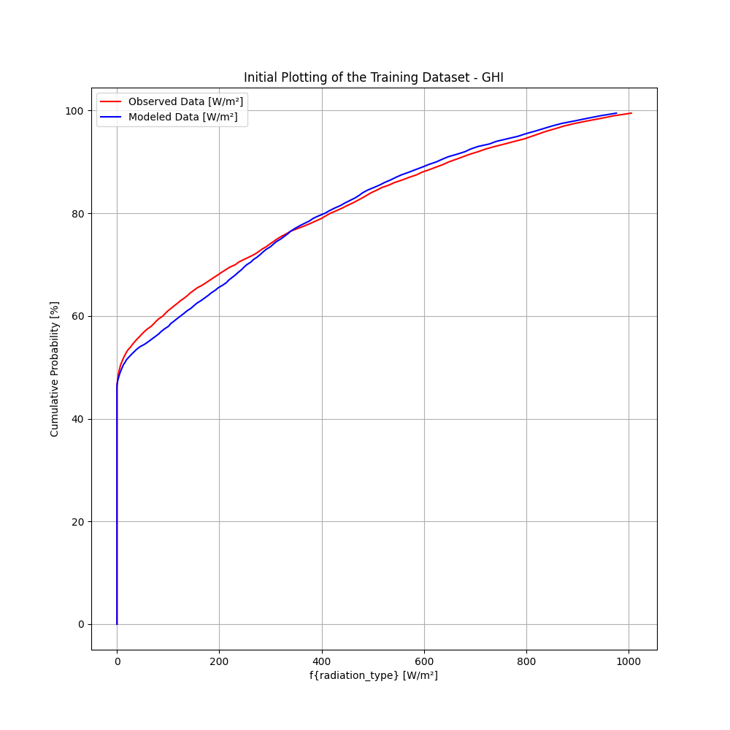
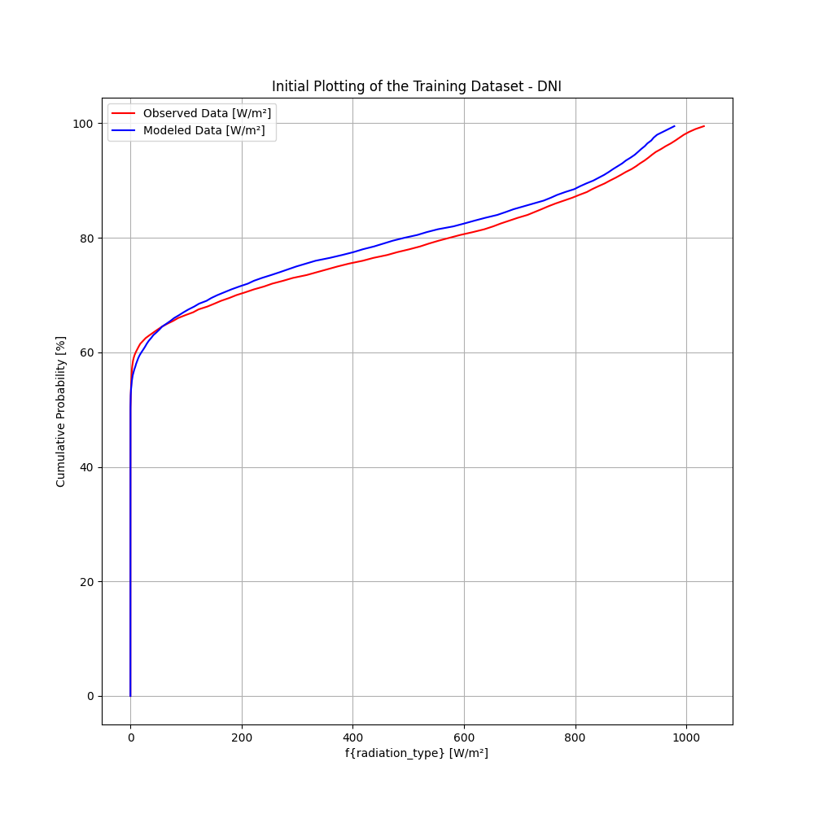
Initial data

Slide 22
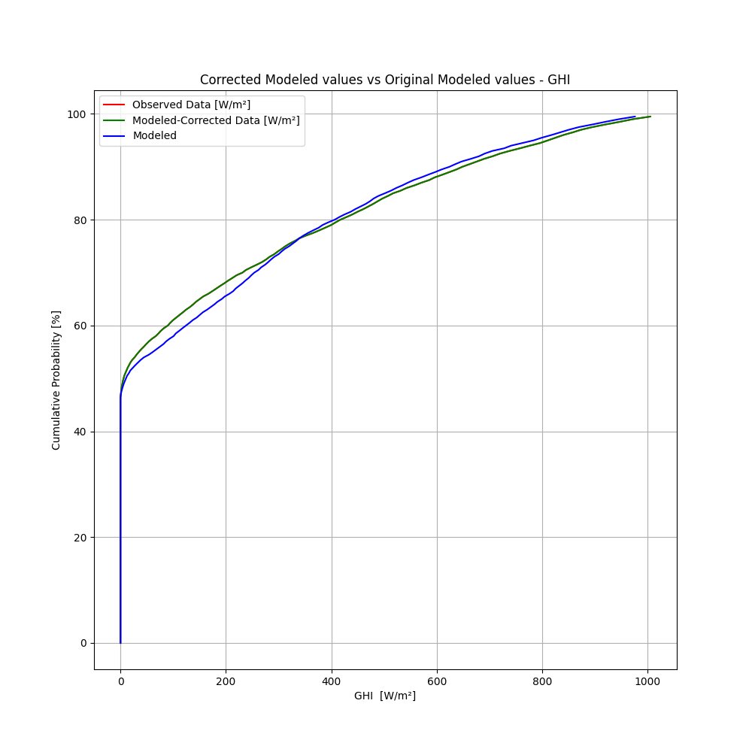
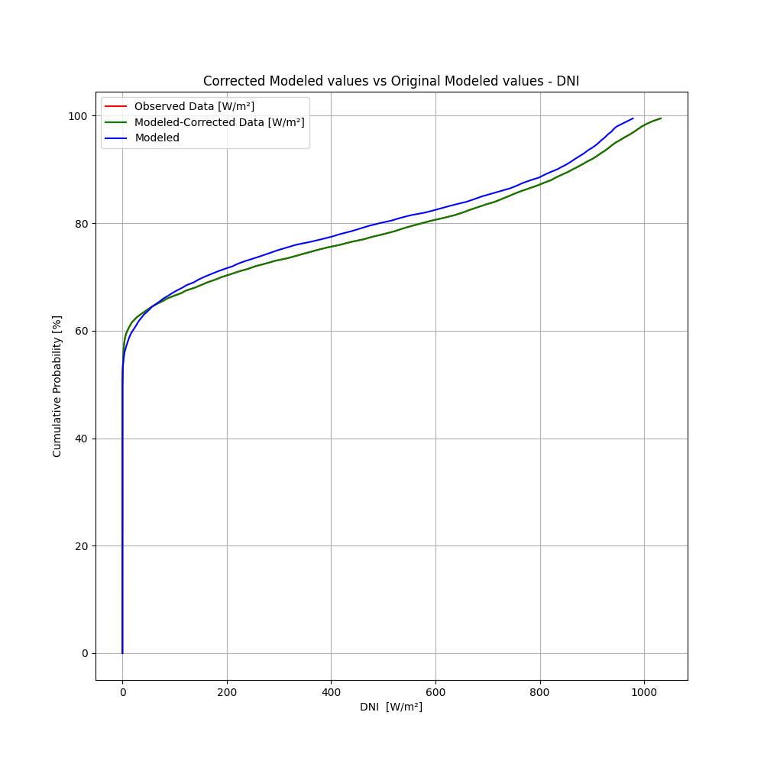
CORRECTED data

Slide 23
 | Initial Data (GHI) | Corrected Data (GHI)
MBE | 1.55 | -0.05
RMSE | 68.07 | 69.12
R² | 0.938 | 0.937
 | Initial Data (DNI) | Corrected Data (DNI)
MBE | -16.00 | 0.08
RMSE | 157.80 | 160.66
R² | 0.790 | 0.789

Slide 24
Evaluating the results
Linear Regression : This method yields strong results for both GHI and DNI. In both cases, the regression slope is equal to 1.00, and the intercept is effectively zero, indicating an excellent fit. MBE is reduced to zero, reflecting the model's unbiased nature. Additionally, a modest improvement in the RMSE is observed, further confirming the method’s effectiveness.
EQM : The EQM method also performs well, as indicated by the substantial overlap between the modelled and observed distributions. Improvements in MBE are evident for both irradiance variables, while RMSE and the R² exhibit minor variations. These results suggest that EQM offers a reliable correction, particularly in aligning the statistical properties of the simulated data with observations.

Slide 25
Testing period

Slide 26
Method 1 : linear regression

Slide 27
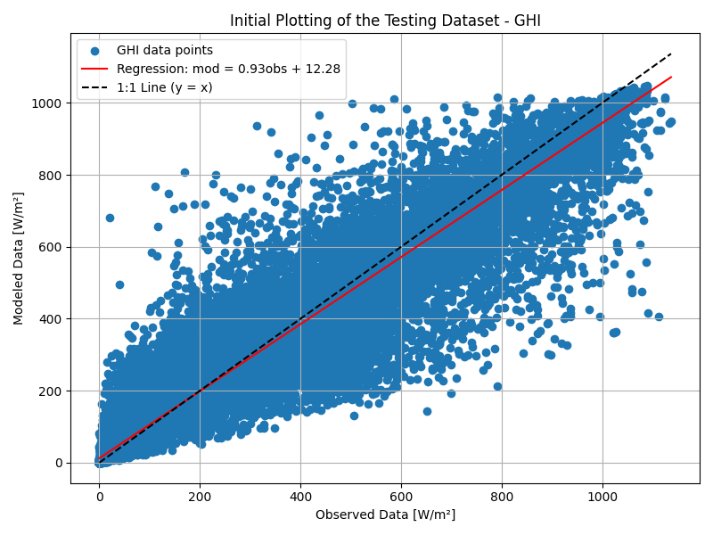
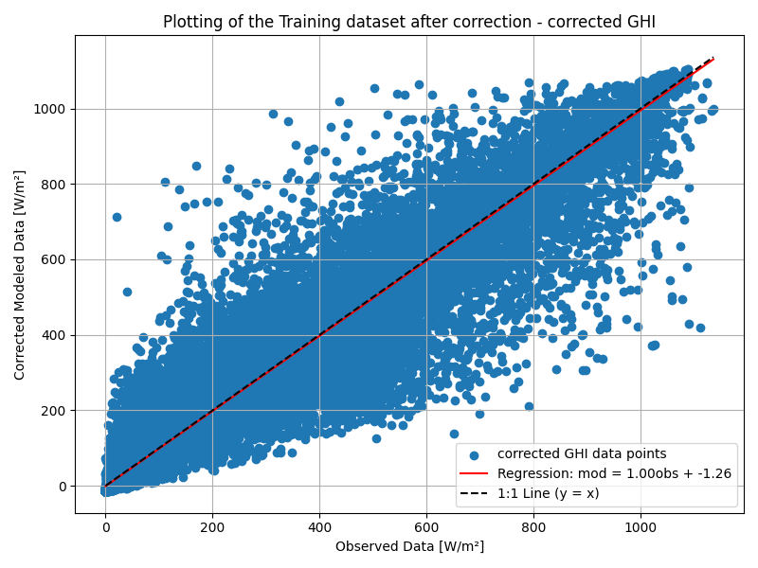
GHI – BEFORE AND AFTER

Slide 28
 | Initial Data | Corrected Data
MBE | -1.00 | -2.08
RMSE | 67.46 | 69.07
R² | 0.944 | 0.944
a | 0.93 | 1.00
b | 12.28 | -1.26

Slide 29
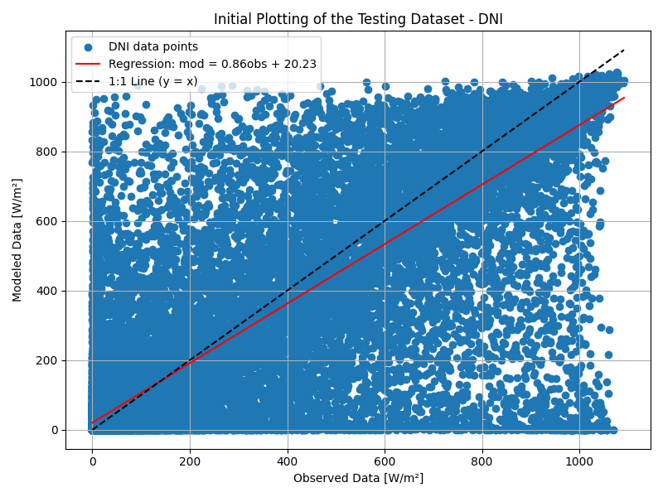
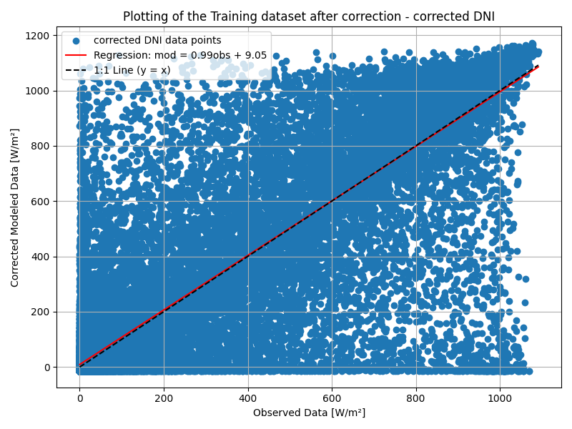
DNI – BEFORE AND AFTER

Slide 30
 | Initial Data | Corrected Data
MBE | -12.40 | 5.88
RMSE | 156.79 | 170.79
R² | 0.801 | 0.801
a | 0.86 | 0.99
b | 20.23 | 9.05

Slide 31
Method 2 : empirical quantile mapping (eqm)

Slide 32
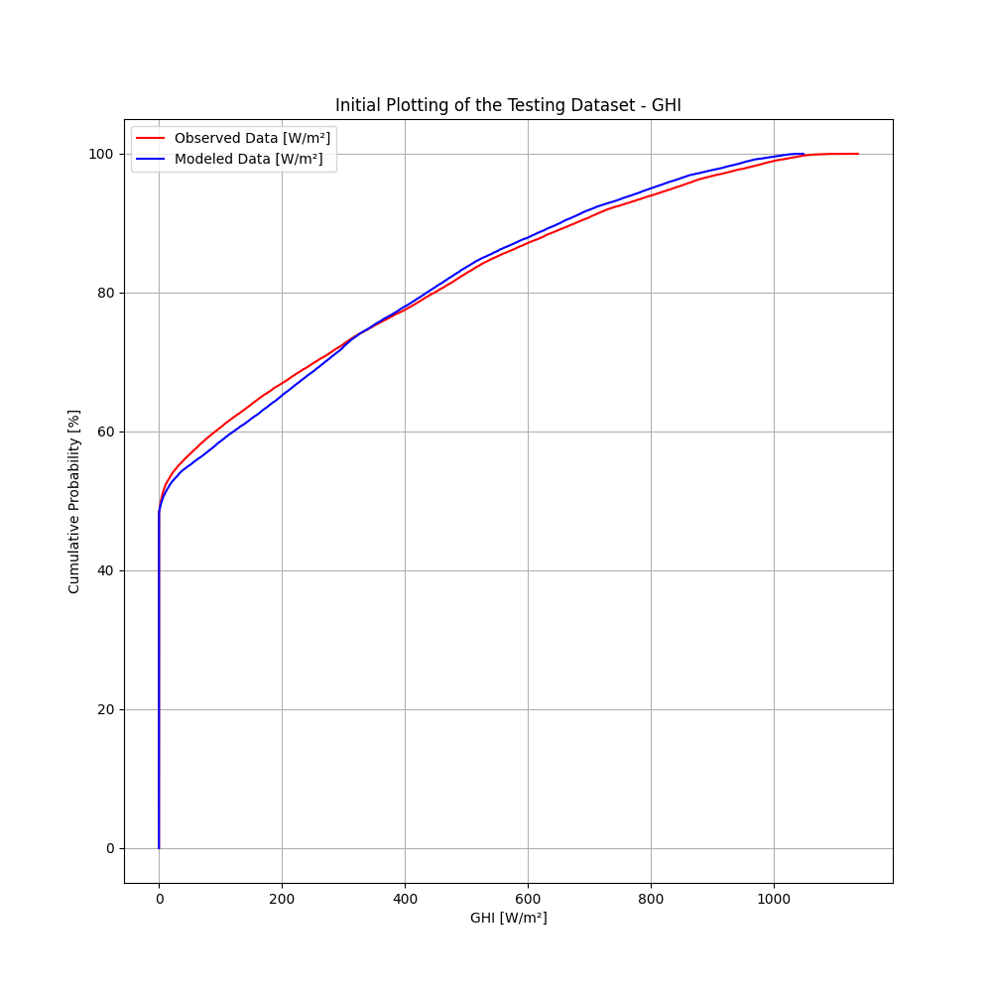
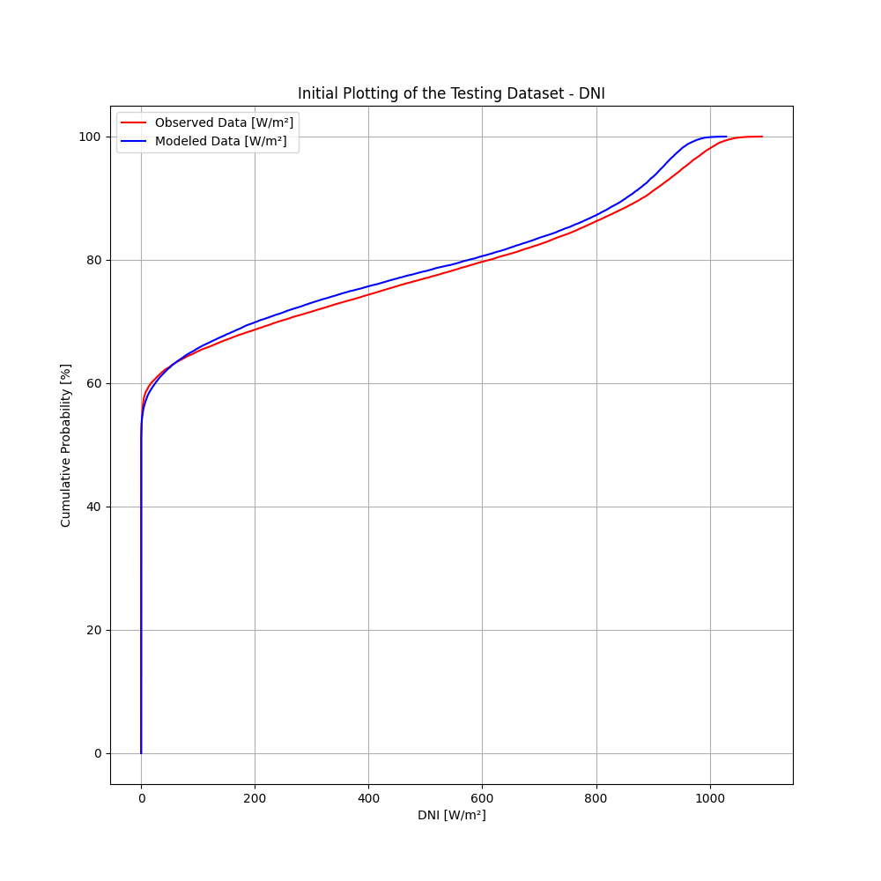
INITIAL DATA

Slide 33
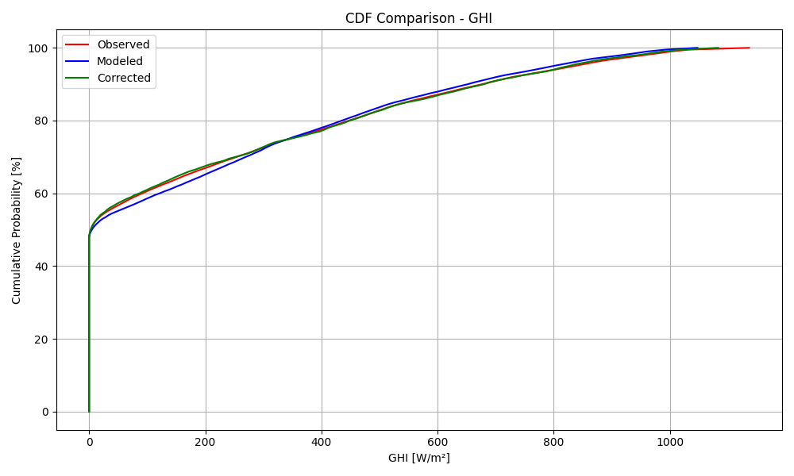
CORRECTED GHI

Slide 34
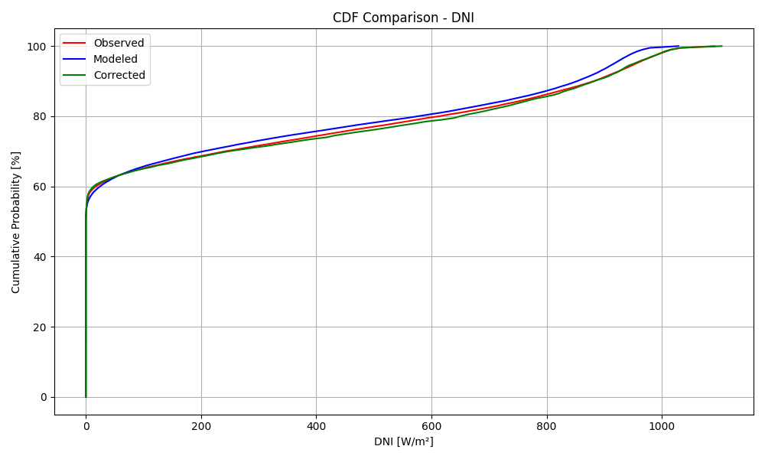
CORRECTED DNI

Slide 35
 | Initial Data (GHI) | Corrected Data (GHI)
MBE | -1.00 | -1.40
RMSE | 67.46 | 68.74
R² | 0.944 | 0.942
 | Initial Data (DNI) | Corrected Data (DNI)
MBE | -12.40 | 4.37
RMSE | 156.79 | 160.93
R² | 0.801 | 0.799

Slide 36
Evaluating the results
Linear Regression : On the testing dataset, the linear regression model demonstrates expected behaviour with minor deviations. For GHI, the estimated slope is 1.00, and the intercept is -1.26. For DNI, the slope and intercept are 0.99 and 9.05, respectively. Although the MBE does not reach zero in either case, it shows notable improvement compared to prior iterations. Contrary to expectations, the RMSE exhibits a slight increase, suggesting a potential overfitting or variability in the test set.
EQM : This method also performs well on the testing dataset. While the cumulative distribution functions (CDFs) of the modelled data do not perfectly align with those of the observed data, they exhibit strong agreement, indicating good calibration performance. Minor variations are observed in the statistical metrics, consistent with the expected adjustments introduced by the quantile mapping procedure.

Slide 37


Thank you for your attention

